Slide 1


Brand & Design System Showcase
A tour of the Cleartax rebrand visual language: color, typography, shape, iconography,
interactive elements, illustration, and how it all shows up in real work.
V1.3
2026 Design System

Slide 2
C O N T E N T S
What's inside
01
Core Color Palette
04
Geometric Shapes
Primary, accent, and neutral tokens
Eight shapes, one visual language
02
Color Usage
05
Iconography
The 50 / 30 / 10 / 10 hierarchy
Minimal line icons on soft-indigo chips
03
Typography Best Practices
06
Real-World Applications
Guardrails for consistent type
How the system shows up in decks
cleartax · 2026 Design System V1.3
02

Slide 3
C O R E C O L O R P A L E T T E
Our color palette follows a clear hierarchy, with primary colors defining the brand,
accent colors highlighting key elements, and neutral colors providing balance.
Primary Colors
Deep Midnight Blue
Greyish White
#05022A
#F0F0F0
Accent Colors
Electric Lime Green
Blueish Indigo
#C8F006
#5446FF
Neutral Colors
Neutral White
Neutral Black
#FFFFFF
#000000
cleartax · 2026 Design System V1.3
03

Slide 4
C O L O R U S A G E
50%
Primarily use clean and bright visuals across all mediums to maintain a premium and positive brand appearance.
30%
A deep corporate midnight blue used to convey an authoritative tone in text and logos.
10%
A splash of vibrant electric green to highlight key elements based on the visual hierarchy.
10%
Used for accents and CTAs.
cleartax · 2026 Design System V1.3
04

Slide 5
T Y P O G R A P H Y B E S T P R A C T I C E S
Our typography guidelines ensure consistency, readability,
and a clear visual hierarchy across all designs.
×
×
×
Do not make the spacing between lines too tight or too loose
Do not use heavy font weights for headlines
Do not use multiple font weights in headlines
×
×
Do not introduce any new typefaces
Do not add icons or images between text
cleartax · 2026 Design System V1.3
05

Slide 6
G E O M E T R I C S H A P E S
Simple geometric shapes create a consistent, modern,
and recognizable visual language across our brand.
cleartax · 2026 Design System V1.3
06

Slide 7
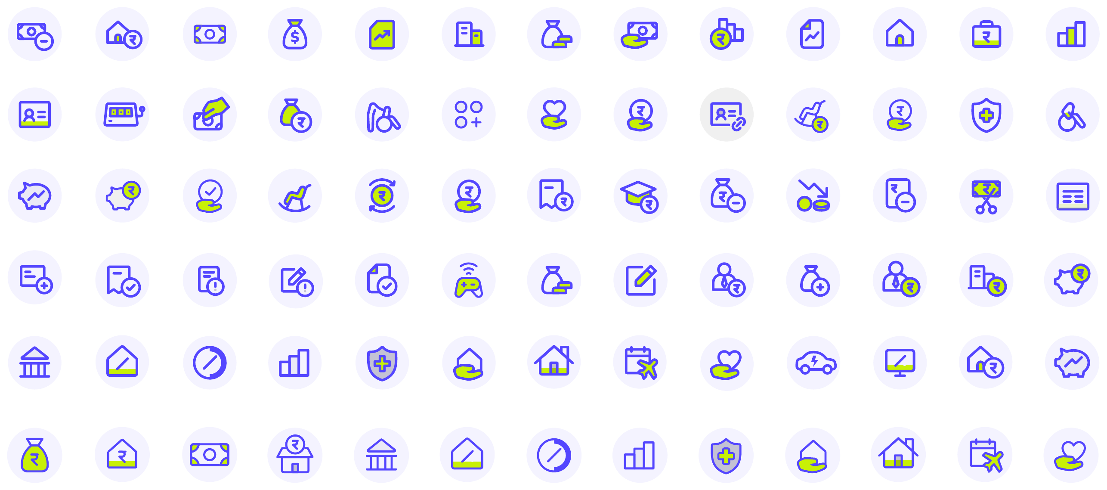
I C O N O G R A P H Y
Clean, consistent, and minimal line icons to
improve clarity and reinforce our visual identity.
cleartax · 2026 Design System V1.3
07

Slide 8
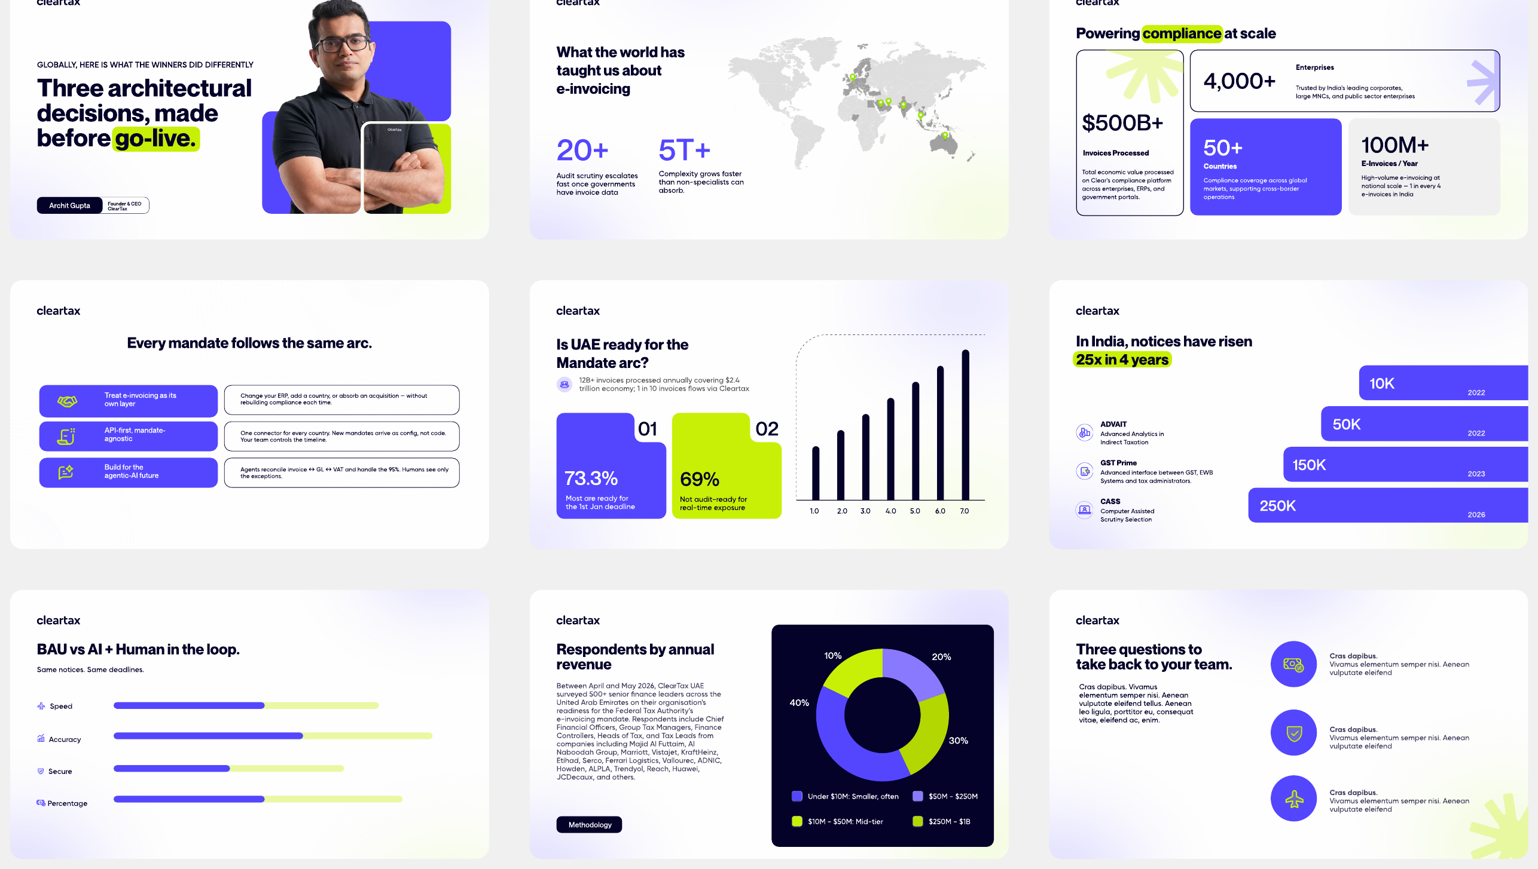
R E A L - W O R L D A P P L I C A T I O N S · D E C K S
cleartax · 2026 Design System V1.3
08

Slide 9


One system. Every touchpoint.
From decks to merchandise, the 2026 rebrand keeps Cleartax consistent,
confident, and unmistakably ours.
Book a demo
cleartax · 2026 Design System V1.3

